Slide 1
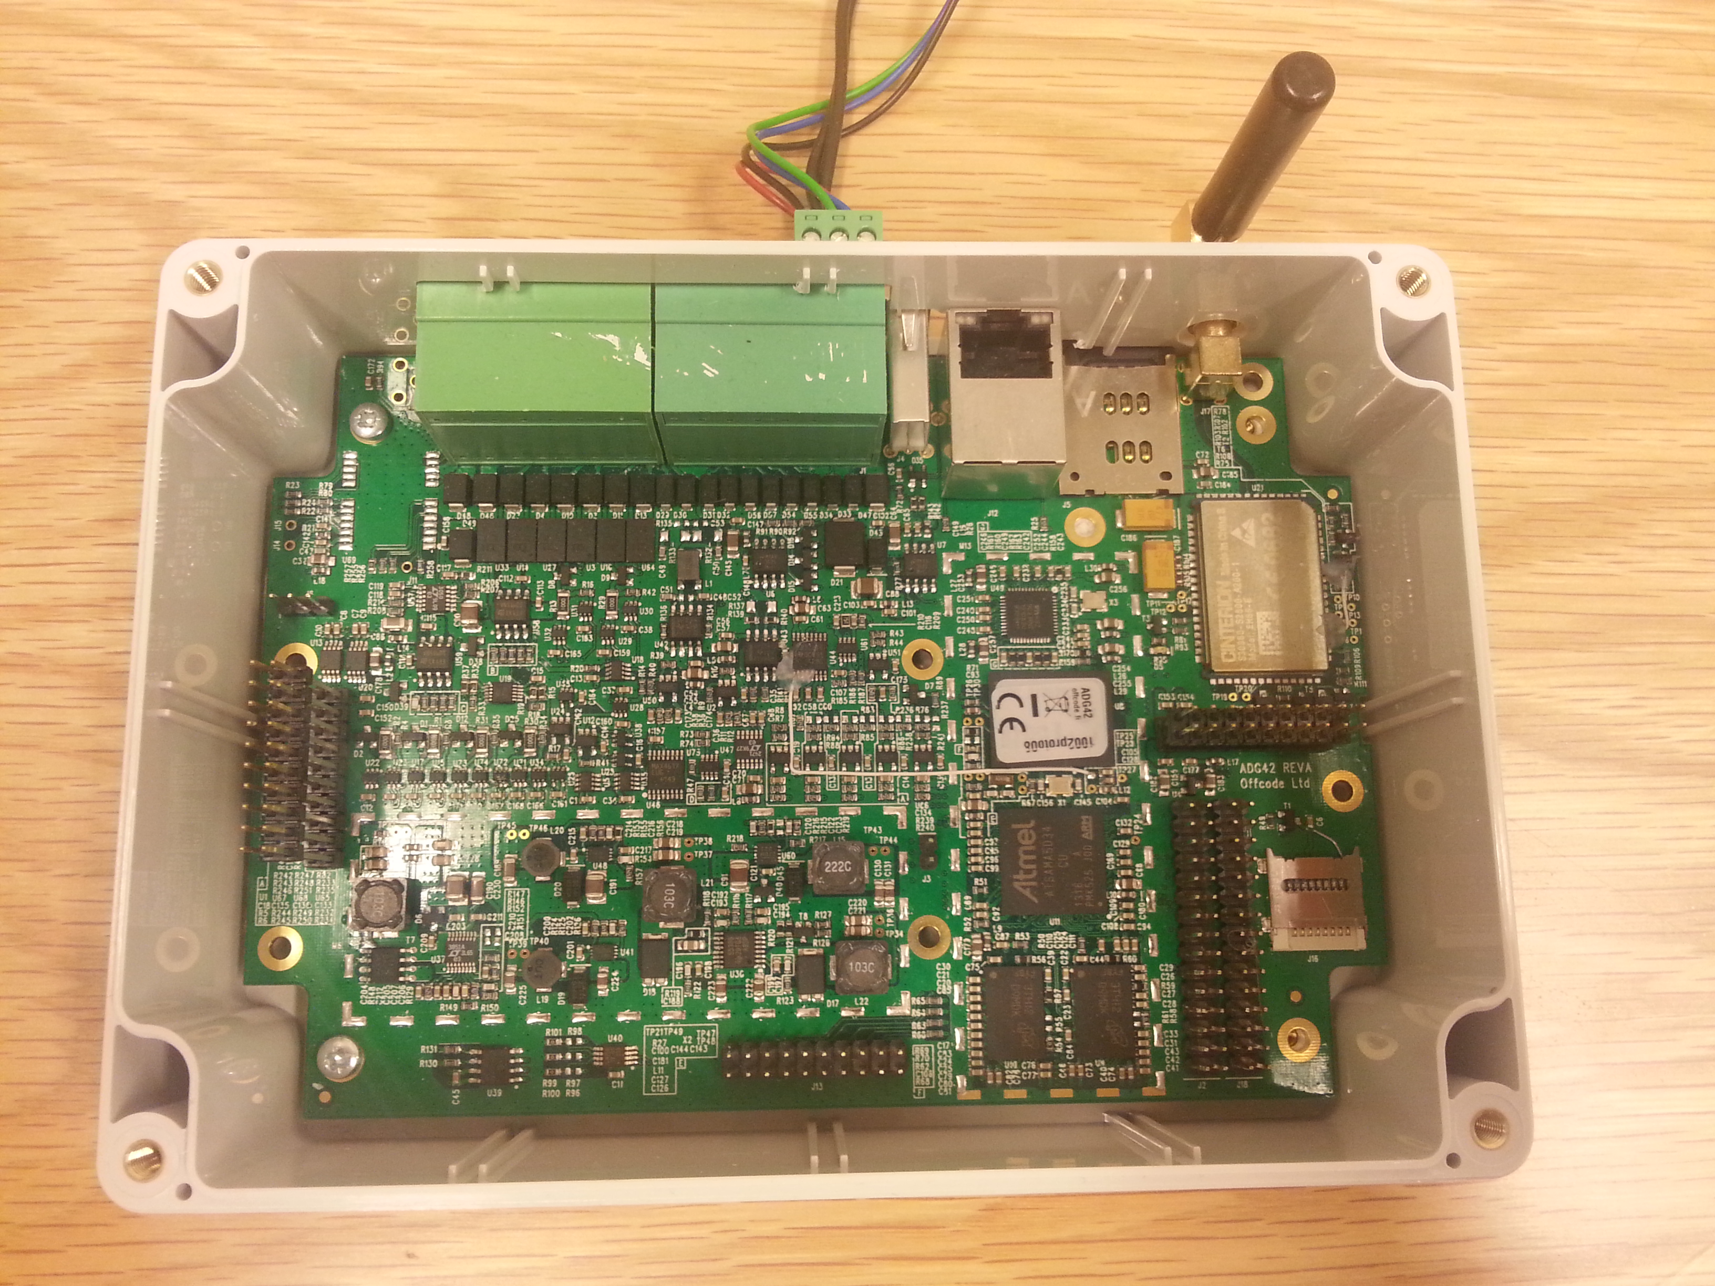
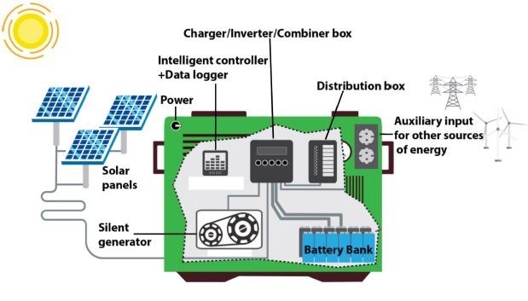
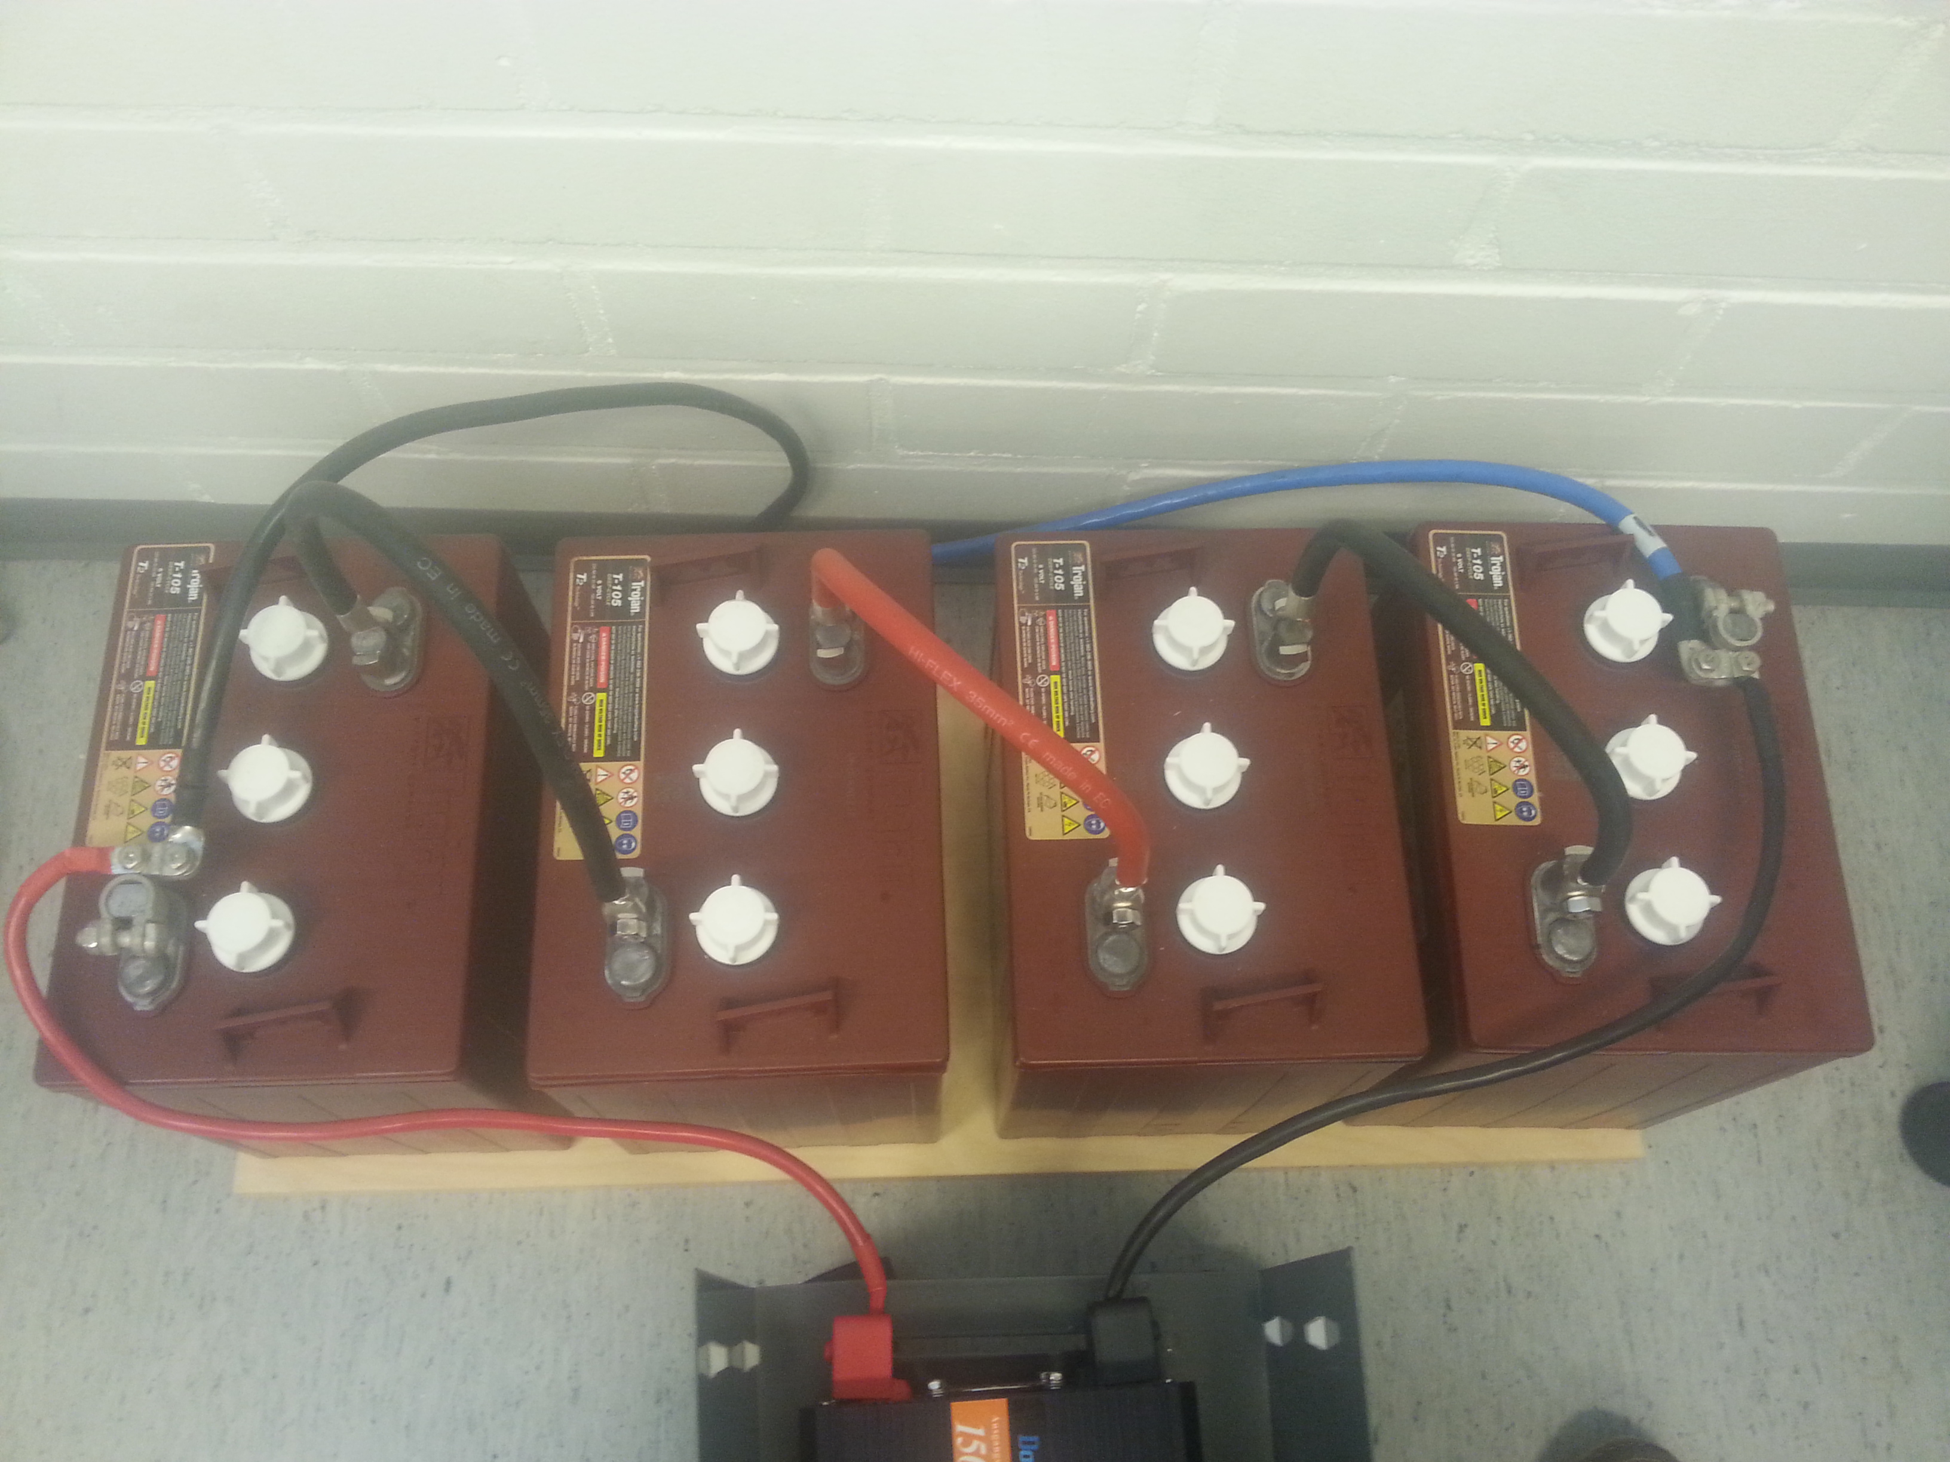
Designing and Assembling a Hybrid System
Sami Matala
School of Engineering and Natural Recources, Information Technology, Software Engineering
Introduction
The subject of this thesis was to design and develop an intelligent controller for hybrid generator for Fineria Energy. Offcode Oy provided AGD42-microcontroller device for this project. Main goal was to create an innovative cleantechdriven hybrid power generator which maximized the use of renewable energy sources. Also, the device had to maximize battery performance in both short and long term.
FIGURE 1. Basic design of the solution
ADG42 microcontroller
ADG42 runs Debian Linux software and is capable of measuring parameters like temperature, pressure, moisture, location, climate or capture video and is also capable of connecting to external sensors. It can be hooked up to cloud services. It supports wireless sensors and has an inbuilt GPS.
Methods
Actual test of connecting the microcontroller to the power system for measuring current flows in and out of the batteries was my main goal in this thesis. Whole data logging and measurement code was done with C-language using own data gathering threads for incoming and outgoing current flows. With these results state-of-charge (SOC)
was solved.
FIGURE 2. Batteries connected in serial
Results
Measurements of current flows gave a good development ground for taking the next step in cleantech hybrid solutions. ADG42 microcontroller was a great data logger and platform for different kinds of sensors. Algorithms for controlling fossil-fuel powered generator was also tested and proven to work.
FIGURE 3. a closer look of ADG42
Conclusions
Hybrid system with tested equipment was enough for making a huge leap for cleaner energy. Although above-mentioned solution is still on a research & development stage we can believe for a better tomorrow.
These hybrid generators will maximize the use of multiple renewable energy sources, backed-up by highly efficient fossil-based source to provide reliable and cost efficient power to areas in need.
References
https://https://www.hindawi.com/journals/isrn/2013/953792/
Thesis
Date of publication: 2016, Summer
Supervisor Pertti Heikkilä

